Slide 1
Avoid Distorting The Data
Notes:
While you may choose to keep your data visualization simple, combining multiple types of charts and diagrams can help tell a more rounded story.
Because people use data visualizations to reinforce their opinions, you should always read data visualizations with a critical eye.
Often enough, writers may be using data visualization to skew the data in a way that supports their opinions, but that may not be entirely truthful.

Slide 2
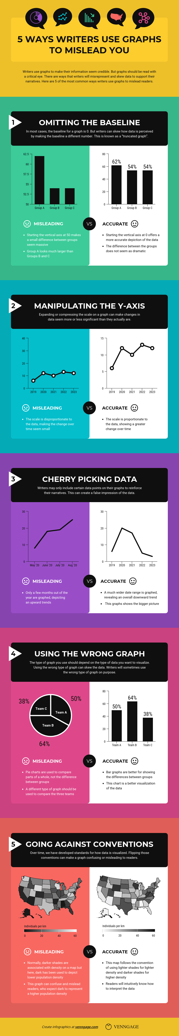
Notes:
Making the baselines something other than 0 to make numbers seem bigger or smaller than they are – this is called “truncating” a graph

Slide 3
Notes:
Compressing or expanding the scale of the Y-axis to make a line or bar seem bigger or smaller than it should be

Slide 4
Notes:
Cherry picking data so that only the data points you want to include are on a graph (i.e. only telling part of the story)

Slide 5
Notes:
Using the wrong type of chart, graph or diagram for your data

Slide 6
Notes:
Going against standard, expected data visualization conventions

Slide 7
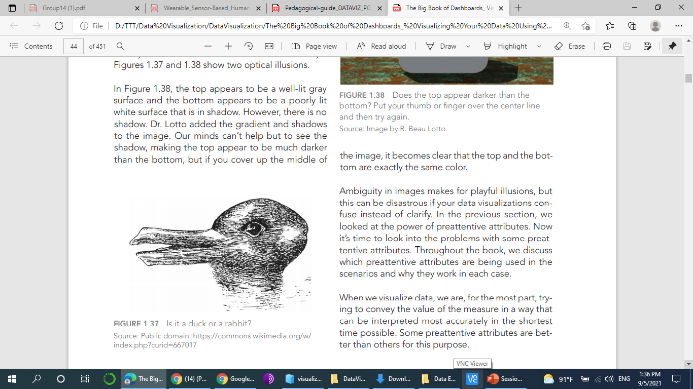
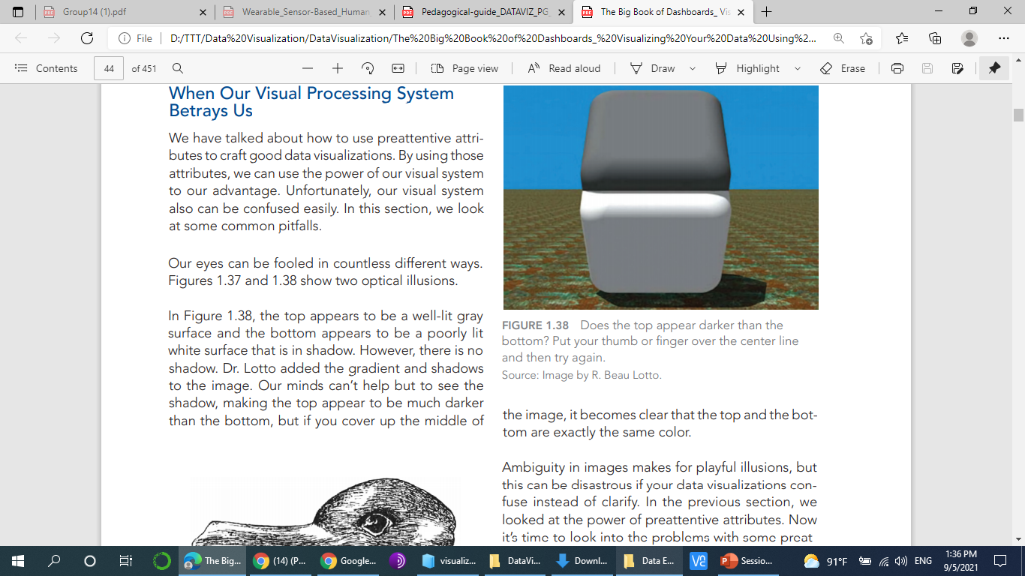
When our visual Processing System Betrays Us
Notes:
We have talked about how to use preattentive attributes to craft good data visualizations. By using those attributes, we can use the power of our visual system to our advantage. Unfortunately, our visual system also can be confused easily. In this section, we look at some common pitfalls.

Slide 8
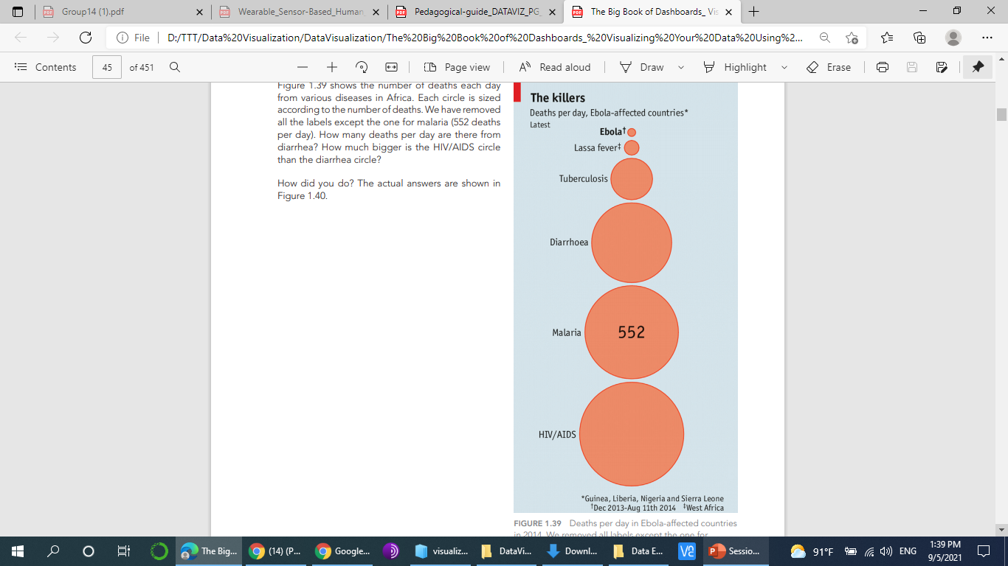
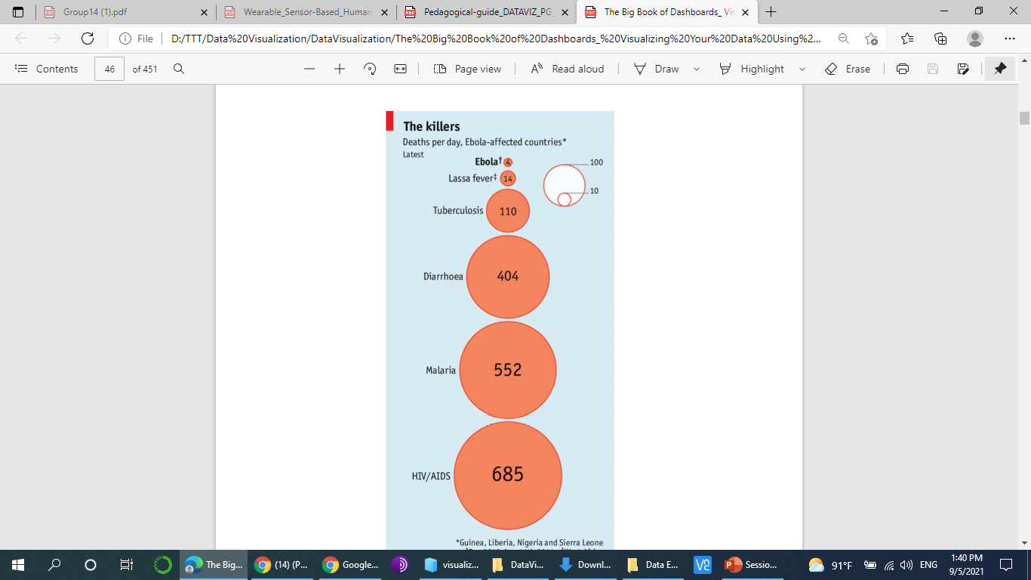
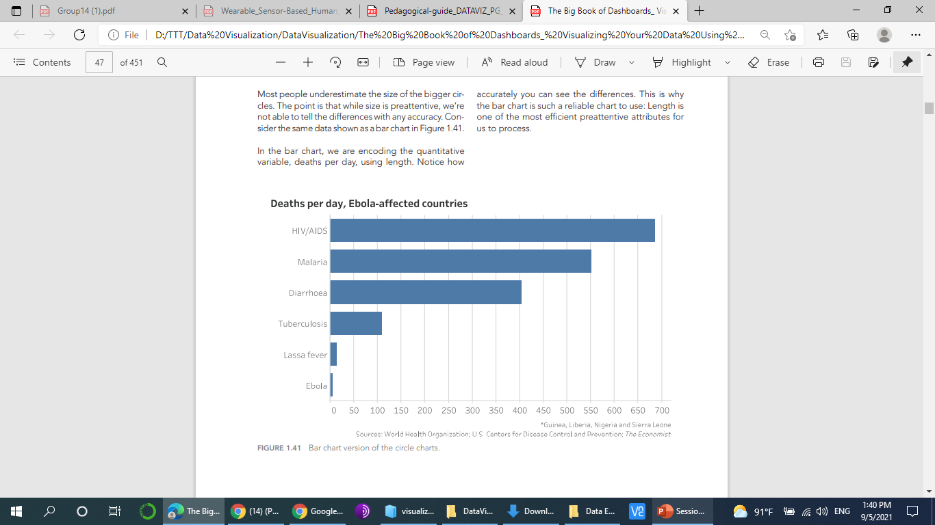
When our visual Processing System Betrays Us
Notes:
Most people underestimate the size of the bigger circles. The point is that while size is preattentive, we’re not able to tell the differences with any accuracy. Consider the same data shown as a bar chart in Figure 1.41. In the bar chart, we are encoding the quantitative variable, deaths per day, using length. Notice how Figure 1.41 Bar chart version of the circle charts. accurately you can see the differences. This is why the bar chart is such a reliable chart to use: Length is one of the most efficient preattentive attributes for us to process.

Slide 9
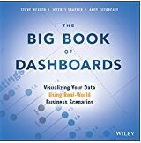
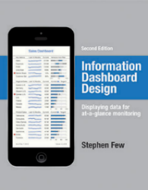
What is a Dashboard?
A dashboard is a visual display of the most important information needed to achieve one or more objectives; consolidated and arranged on a single screen so the information can be monitored at a glance.
A dashboard is a visual display of data used to monitor conditions and/or facilitate understanding.
Notes:
dashboard is a visual display of data used to monitor conditions and/or facilitate understanding
A data dashboard is an information management tool used to track, analyze, and display key performance indicators, metrics, and data points. You can use a dashboard to monitor the overall health of your business, department, or a specific process
Dashboards aggregate data from multiple data sources. A dashboard isn’t just about saving time, but seeing all of your data together in one place. The connection between your data isn’t another API call—it’s you and the expertise you bring to the metrics that are the power behind your business.

Slide 10
Are All Dashboards the Same?
NO!

Slide 11
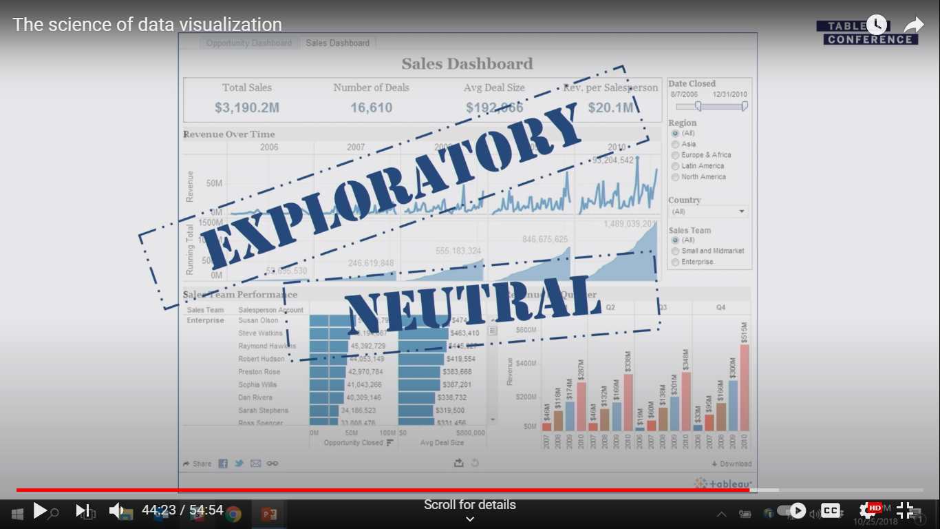
Are All Dashboards the Same?

Slide 12
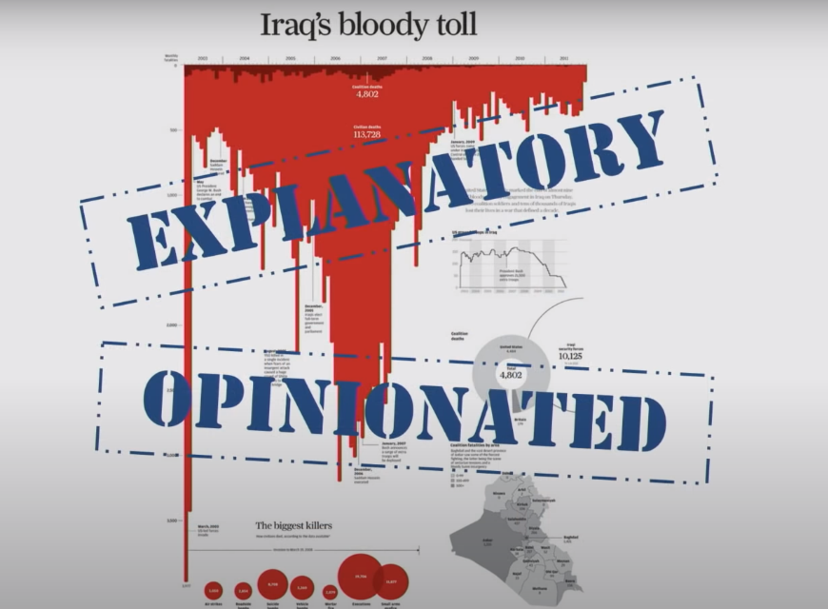
Are All Dashboards the Same?

Slide 13
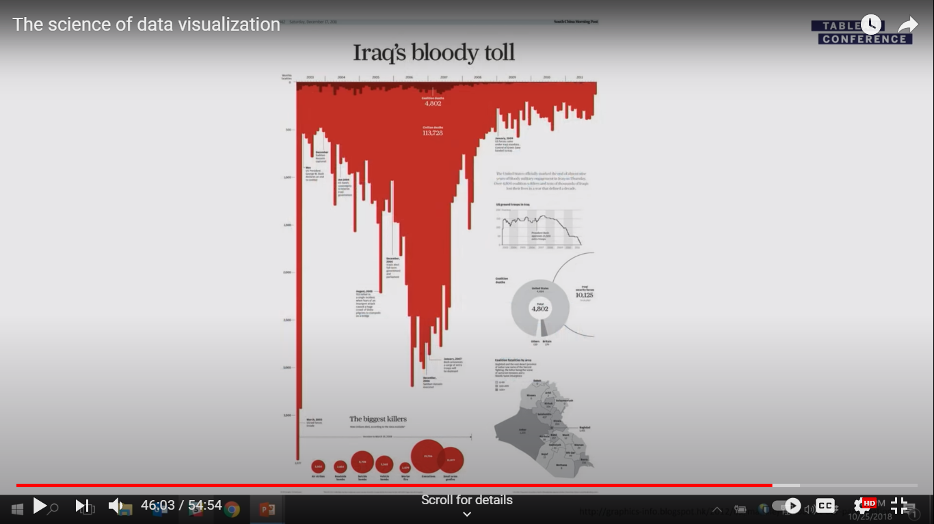

Slide 14
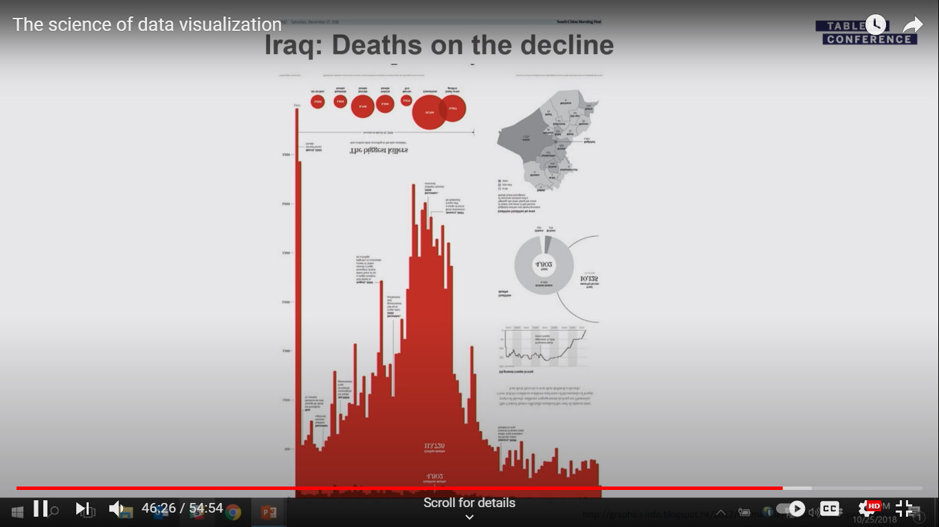
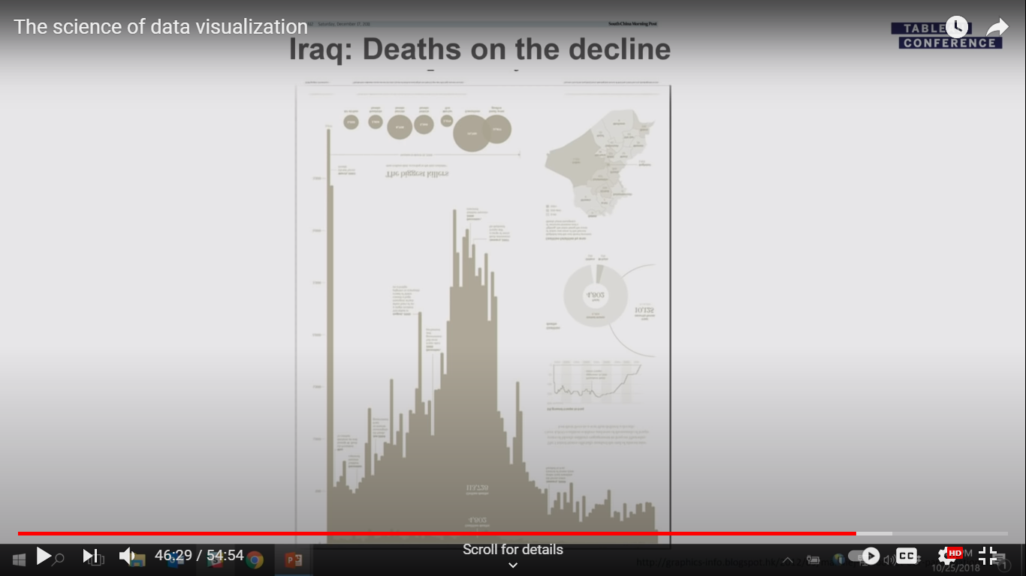

Slide 15


Slide 16
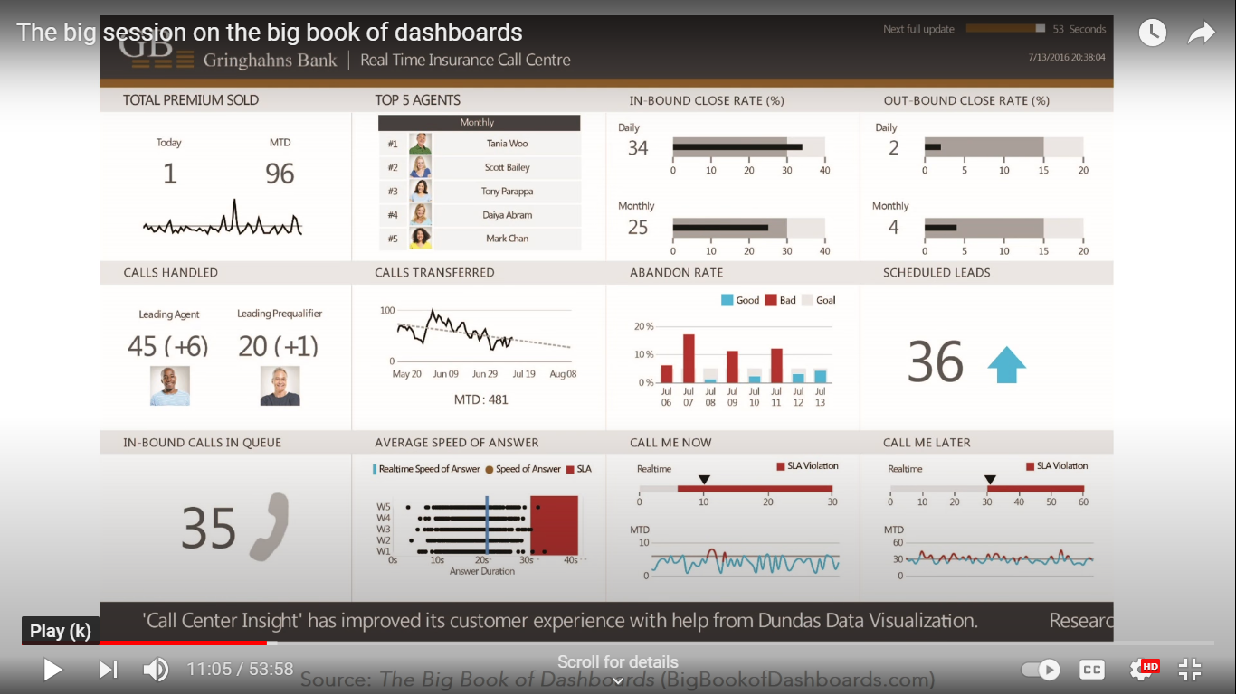
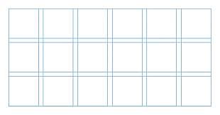

Slide 17
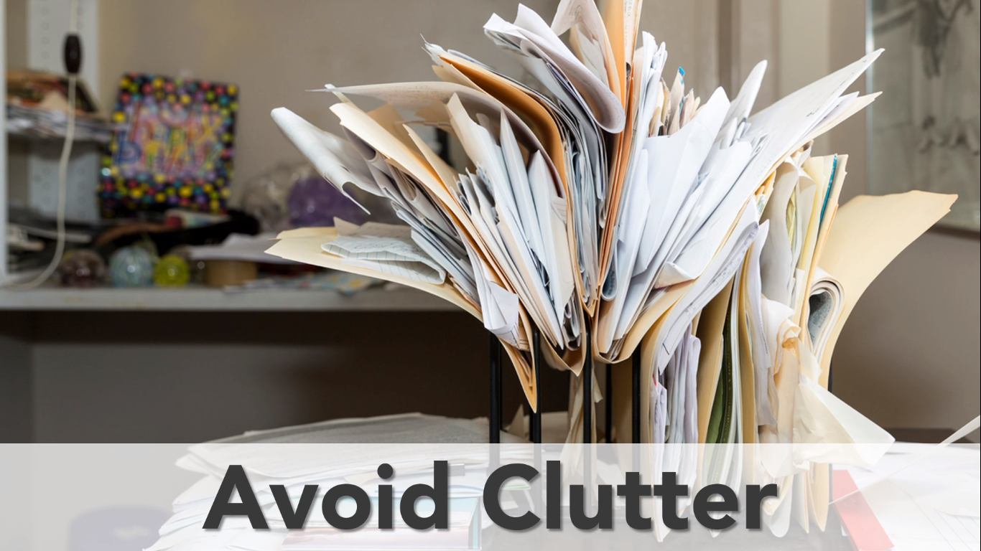

Slide 18
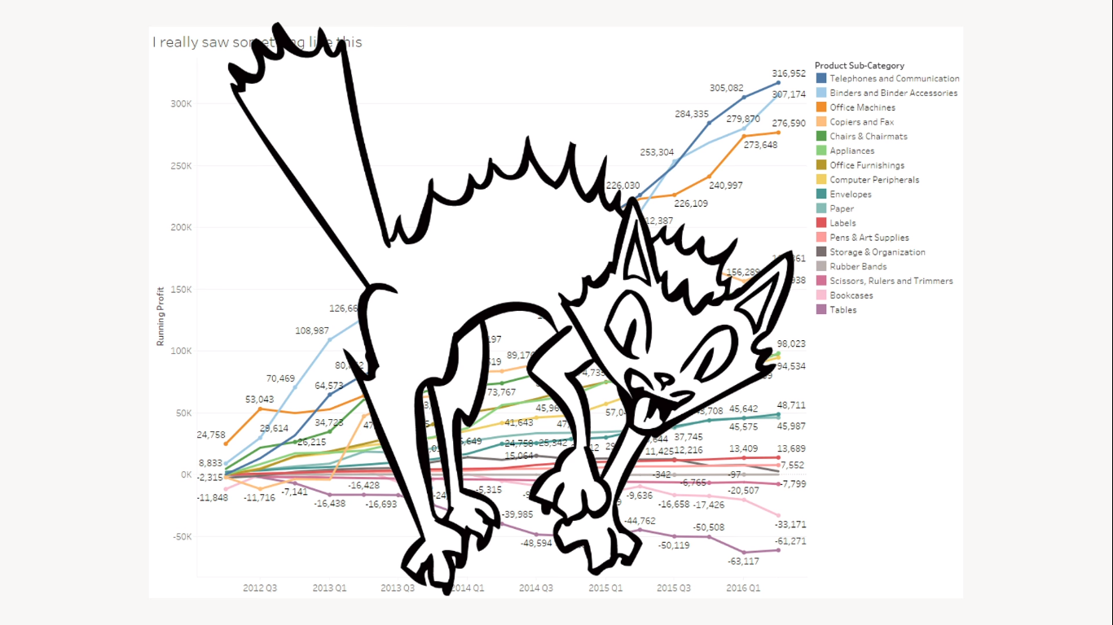
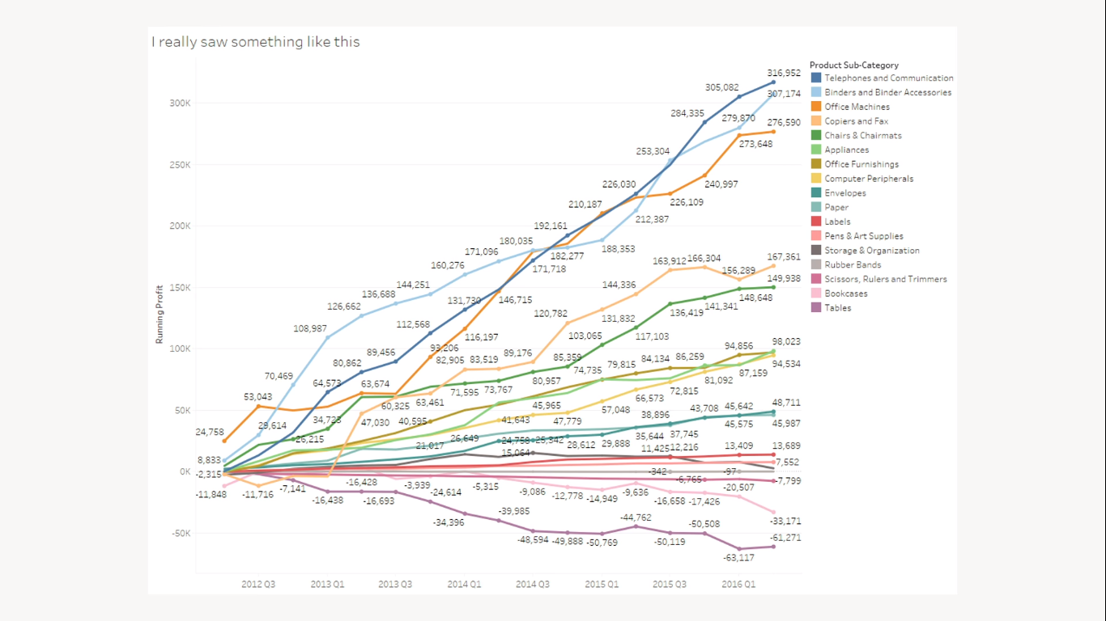

Slide 19
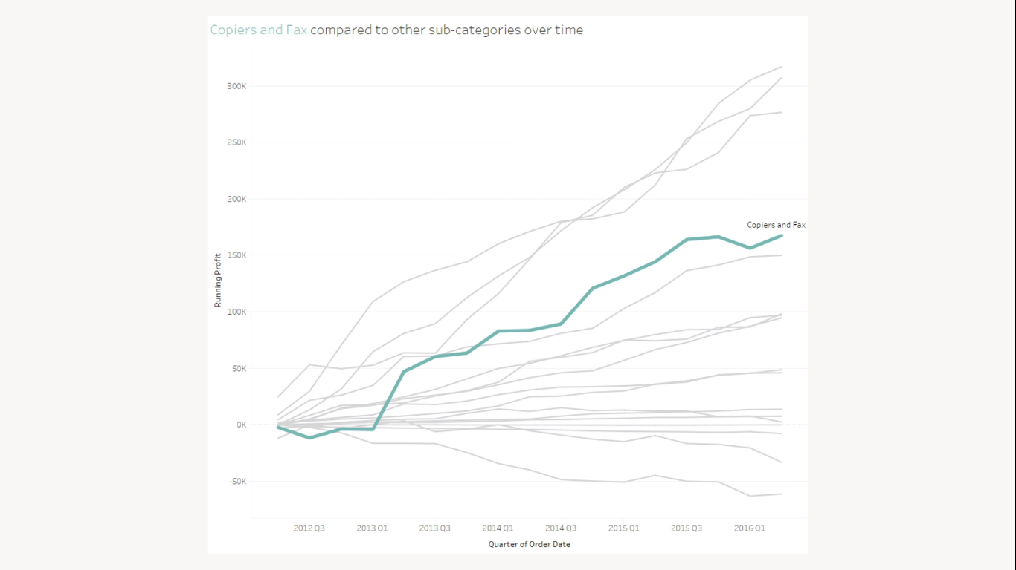

Slide 20
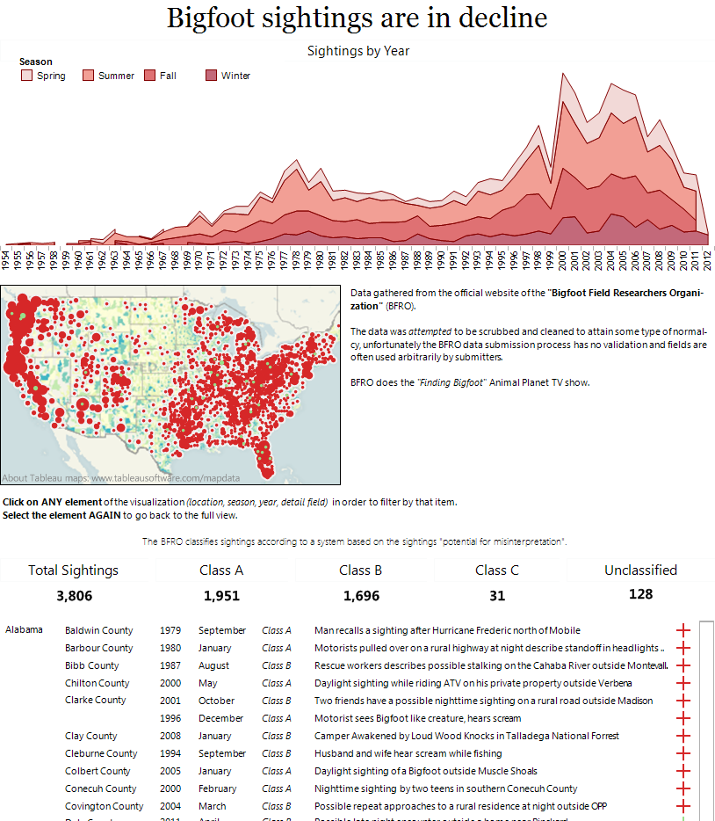
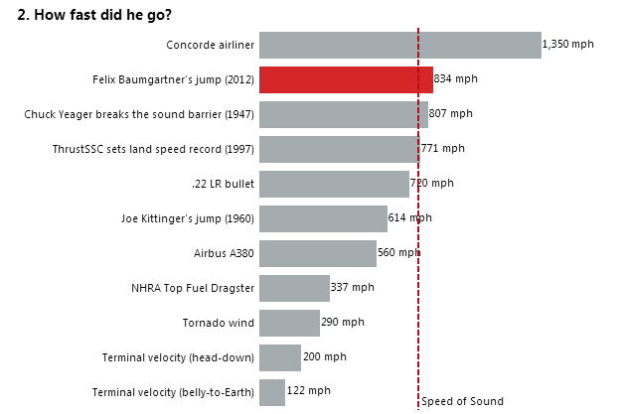
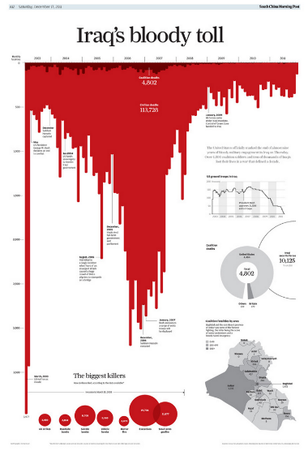
Do your titles capture attention?
Notes:
A concise, descriptive title can make a huge difference in garnering attention and making a chart more memorable
The title should get inside the users brain and spark interest. It can excite, scare, be controversial, drive curiosity, invoke emotion, educate or be intriguing.
Bigfoot sightings are in decline – not super attention grabbing but in the title supports the context below by showing the sightings over time
How fast did he go? – My attention is grabbed. The design of the dashboard draws me to the red bar (prior context this is Felix Baumgartner’s jump to Earth from a helium balloon). I can quickly rank and compare how fast he went vs other common dimensions. The reference line is a nice touch as it adds an additional element of comparison.
Iraq’s bloody toll –this dashboard was published in South China’s Morning Post by Simon Scar– the word choice in the title is matched by the attention capturing bar chart – yes this is just an inverted bar chart made to look like blood.

Slide 21
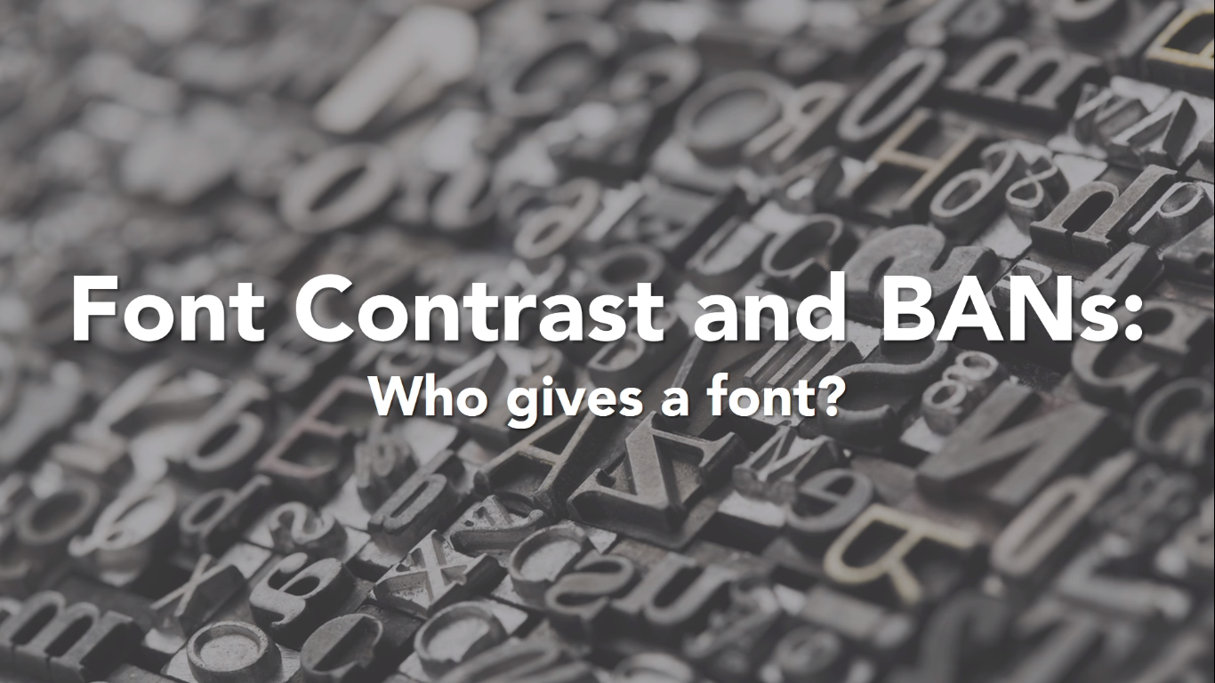

Slide 22
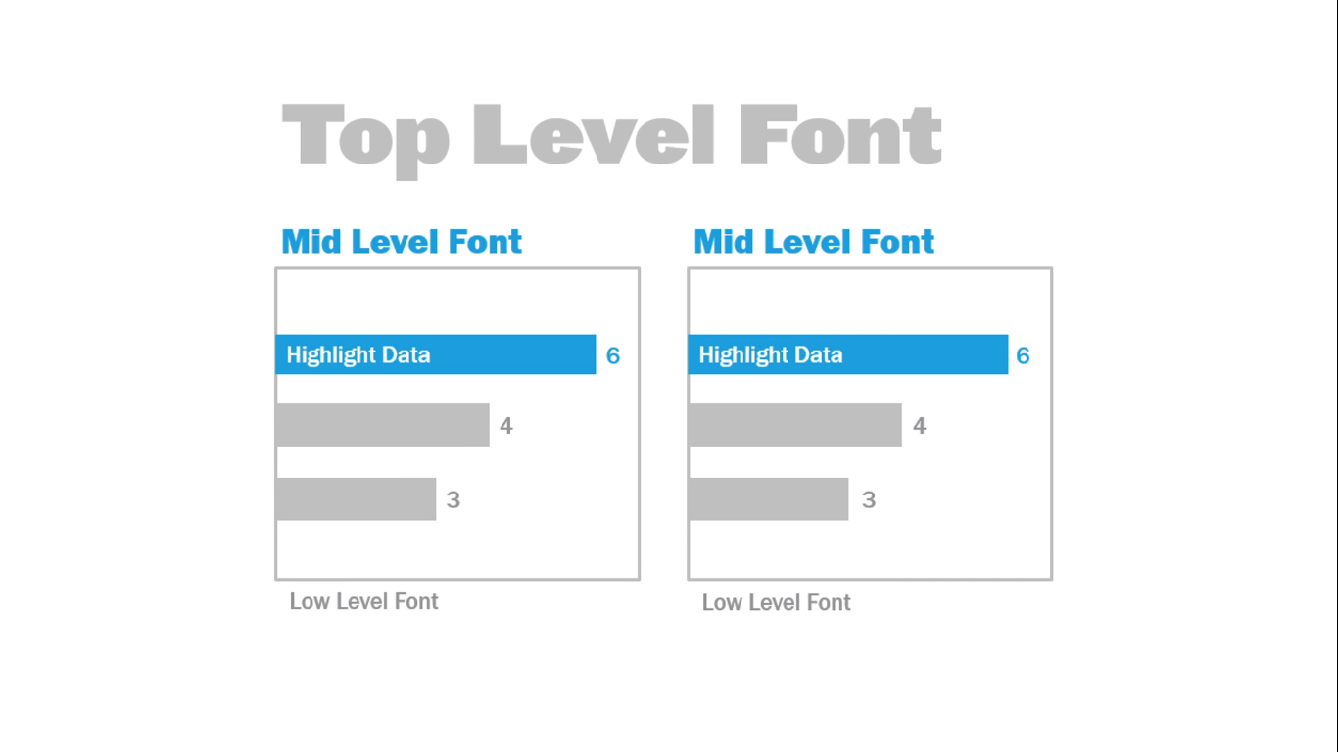

Slide 23
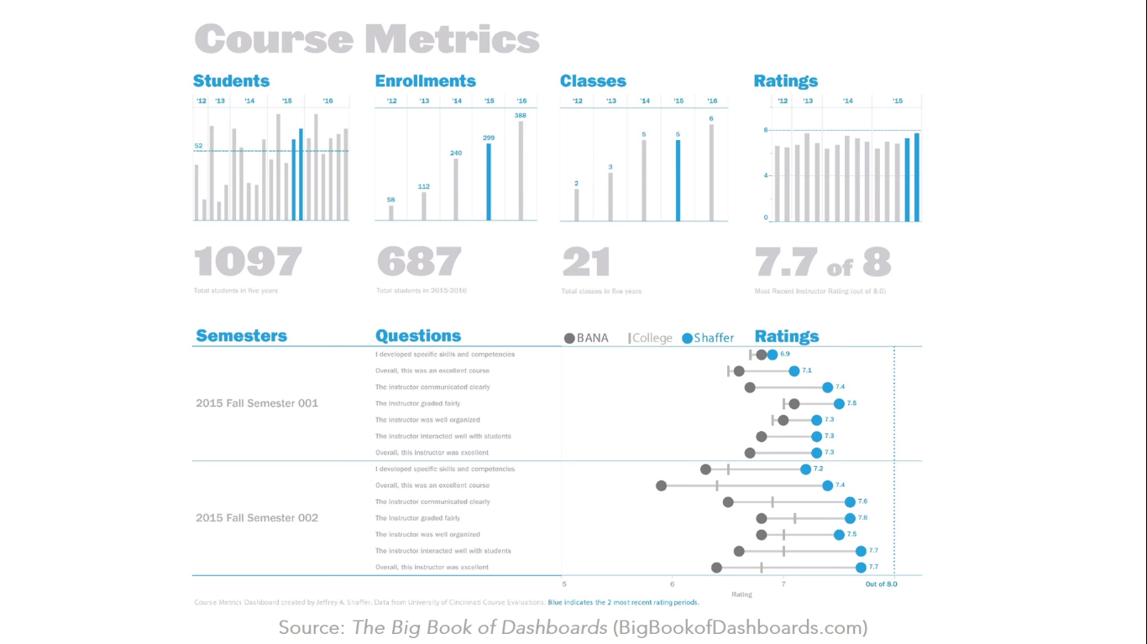

Slide 24
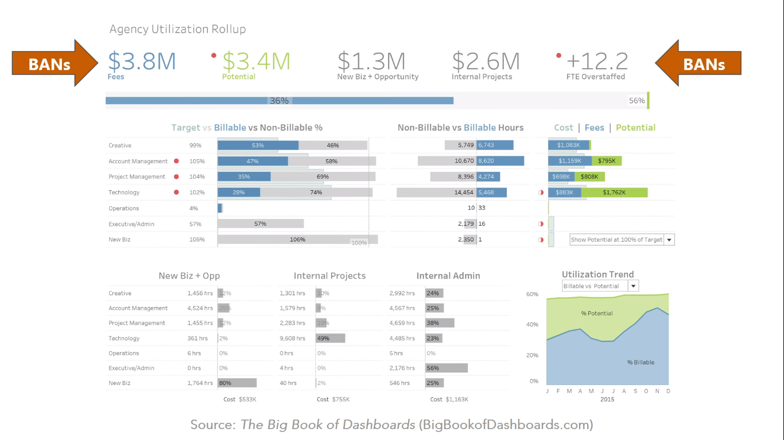

Slide 25
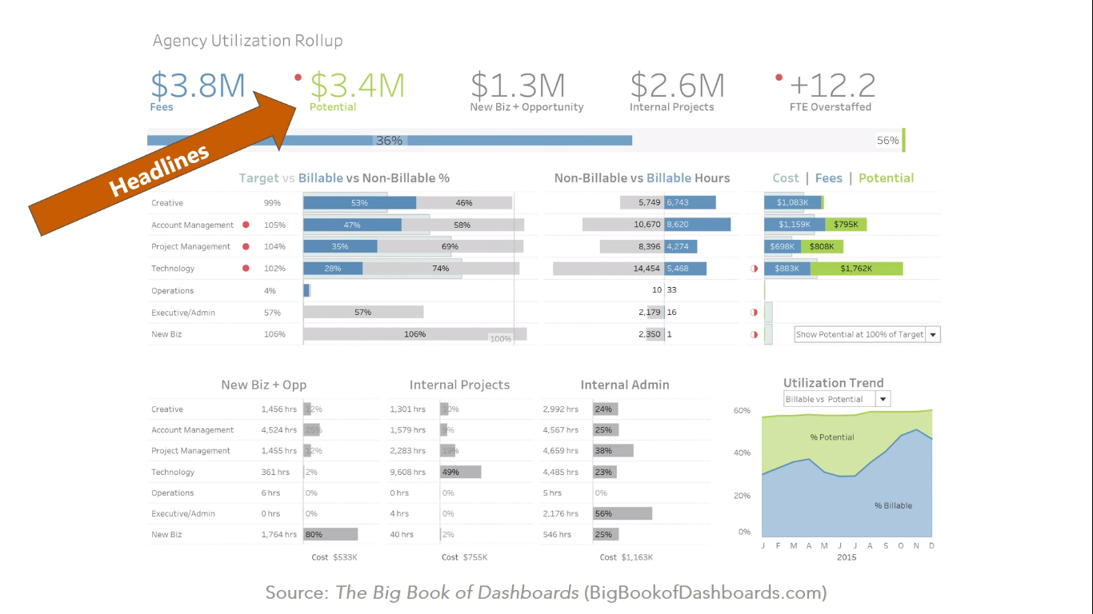
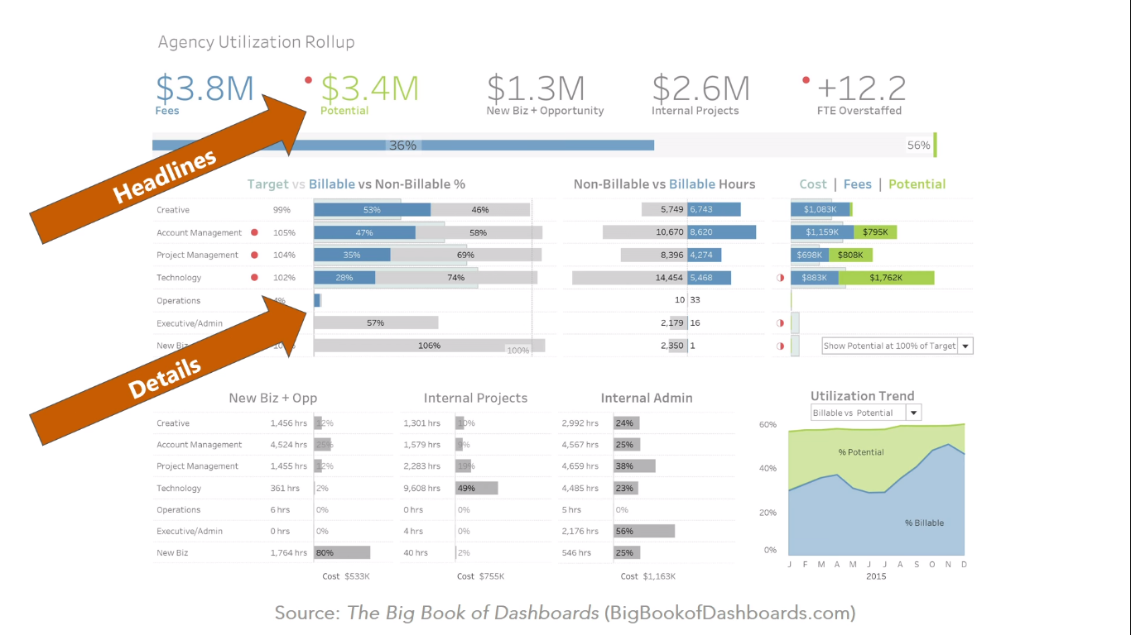

Slide 26
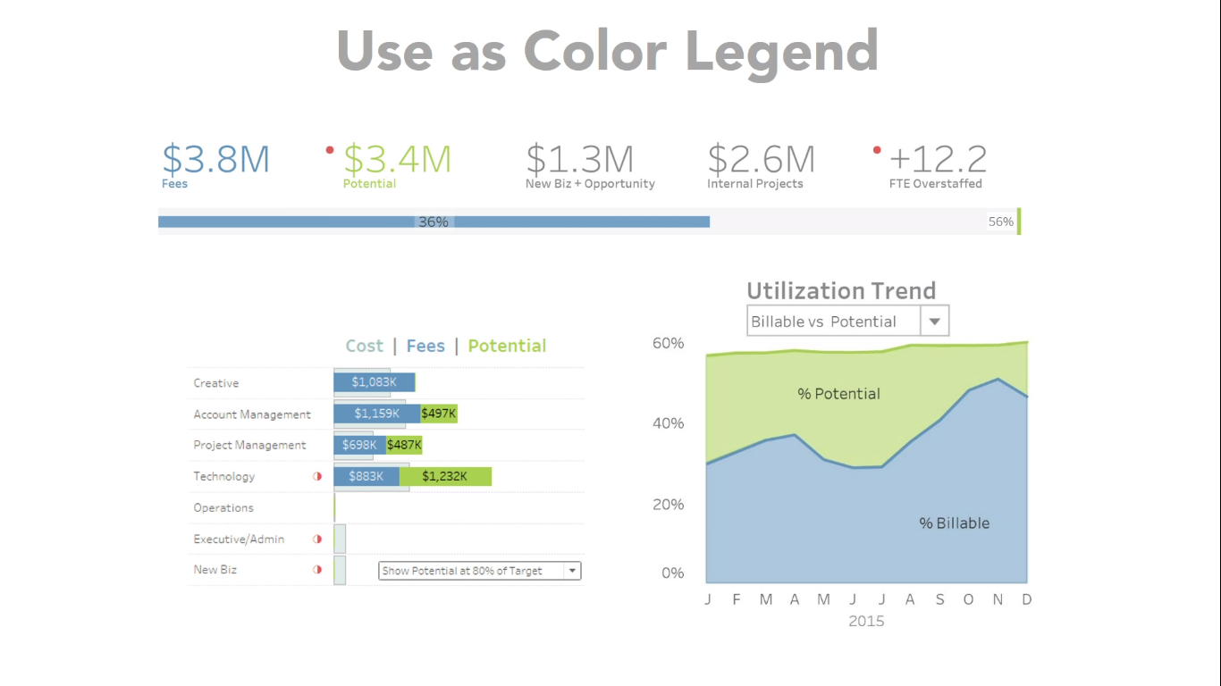

Slide 27
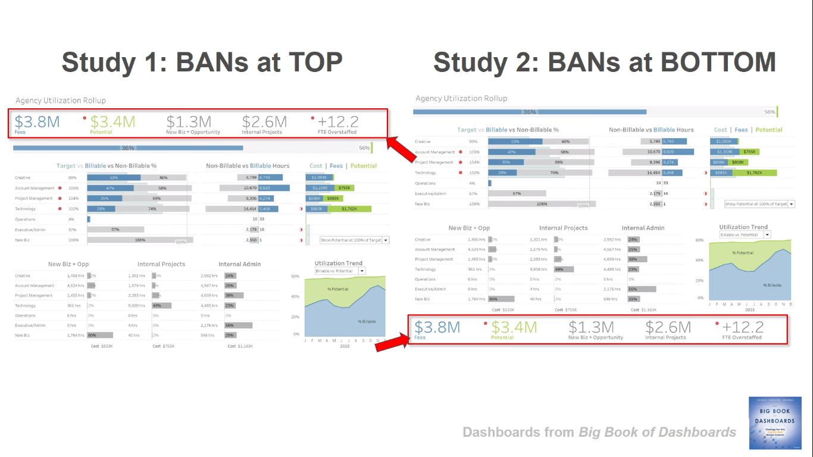

Slide 28
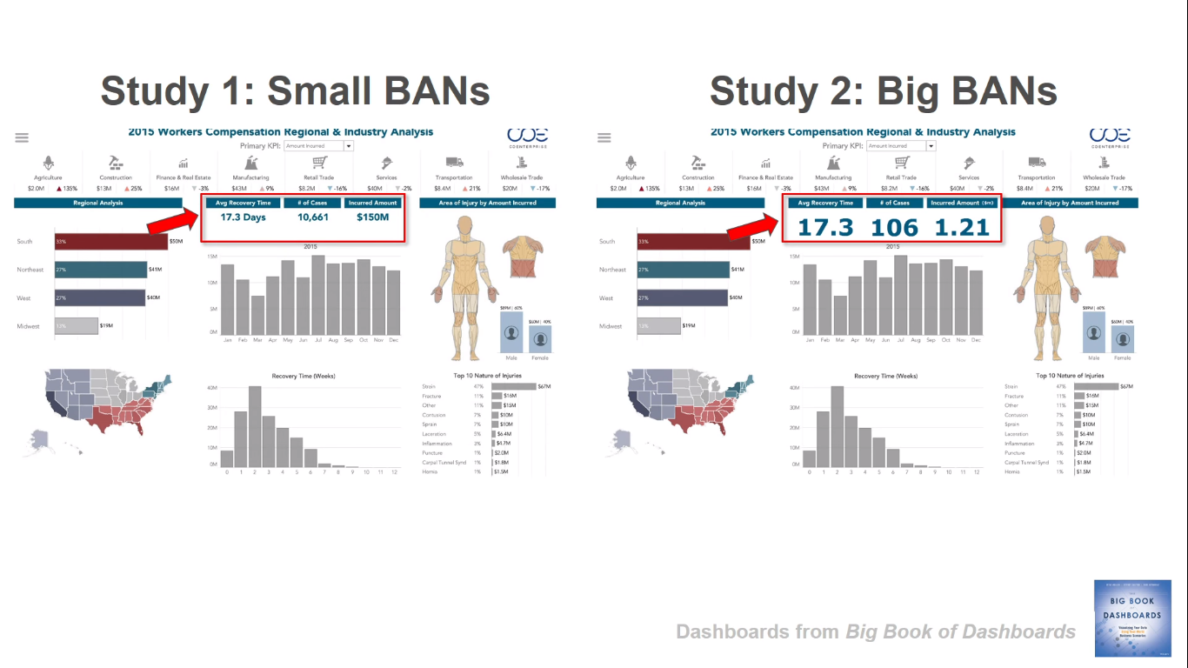

Slide 29
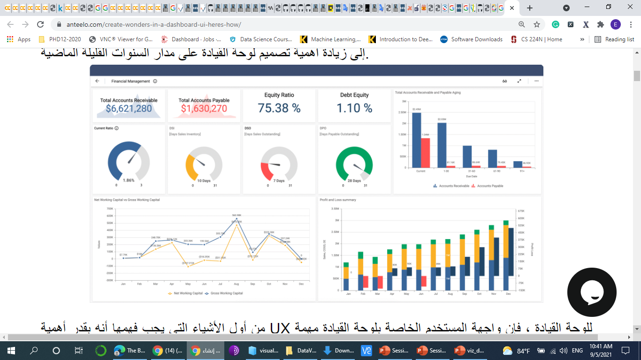

What makes a good dashboard?
Answers a set of questions
Follows a flow and invites interactivity
Specific to and customized for the dashboard’s audience and objectives
Provides appropriate text for clarity and direction, if needed
Makes strategic use of color
Notes:
When it comes to visual best practices, there aren’t any hard and fast rules, such as “do this and never do that.” It isn’t a black and white process. There are, however, guidelines that make sense most of the time. Many of these derive from studies done on how we as humans process things like color, shape, and size. When you really understand the concepts driving these guidelines, only then should you break them.

Slide 30
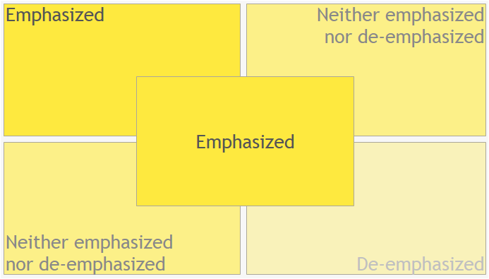
-
What Goes Where?
Notes:
Are you emphasizing something in particular? Do you have it where it will catch someone’s eye?

Slide 31
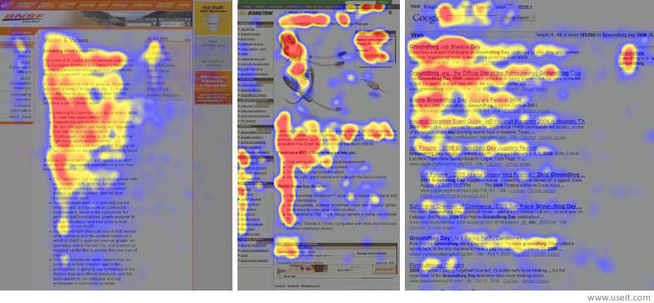
What Goes Where?
Notes:
How do people read web pages? They’re really interested in the top left.
Then they drift across to the right a fair way.
Then they figure they’ll go back and down a bit.
But then they get bored and drift all over the place.
Therefore – the most important thing should be in the top left: the headline, the instructions, the most important chart.
The logo should be in the bottom right!
Additional resources:
https://www.tableau.com/about/blog/2017/6/eye-tracking-study-5-key-learnings-data-designers-everywhere-72395
https://www.tableau.com/learn/webinars/eye-tracking-what-it-teaches-us-about-dashboard-design

Slide 32
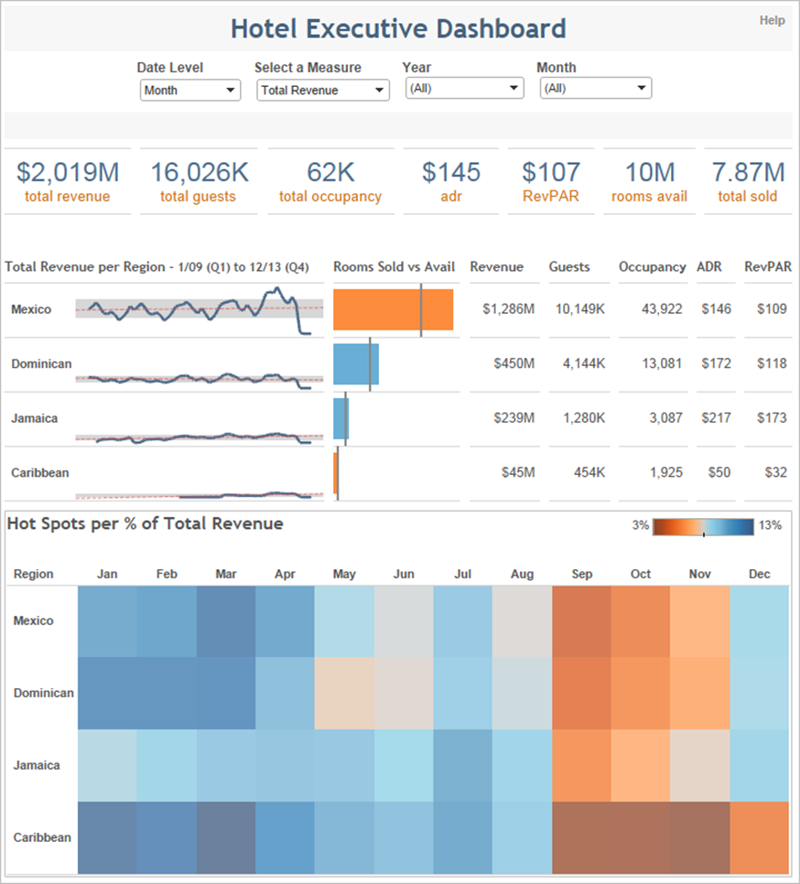
Layout
Filters at the top, so user knows when and how to start interacting.
Most important information at the top and centered.
Starts with the highest level and works down to more precise details.
Most Newsworthy Info
Who? What? When? Where? Why? How?
Important Details
Other General Info

Slide 33
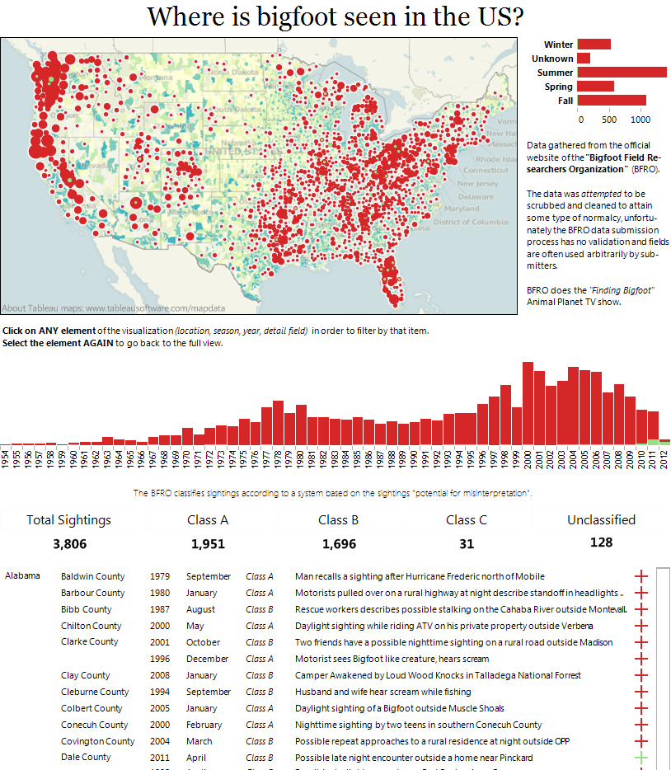
Notes:
Let’s have a quick look on how the top left (and title) control the message
The message is the geographical distribution. What if we want the trend over time to be the message? How would we change the title and the graphics?

Slide 34
Notes:
Now we have a totally different message with exactly the same data – I’ve moved the time series to the top, and included the season data too. With this and the title, the dashboard’s message is completely different.

Slide 35
DONT BE AFRAID...
WHITE SPACE
Notes:
Sometimes we see empty space on our dashboard canvas and become overcome with this insatiable need to fill it. DON’T GIVE IN!
Allow your dashboard to breath…
White space can provide balance to your dashboard and

Slide 36
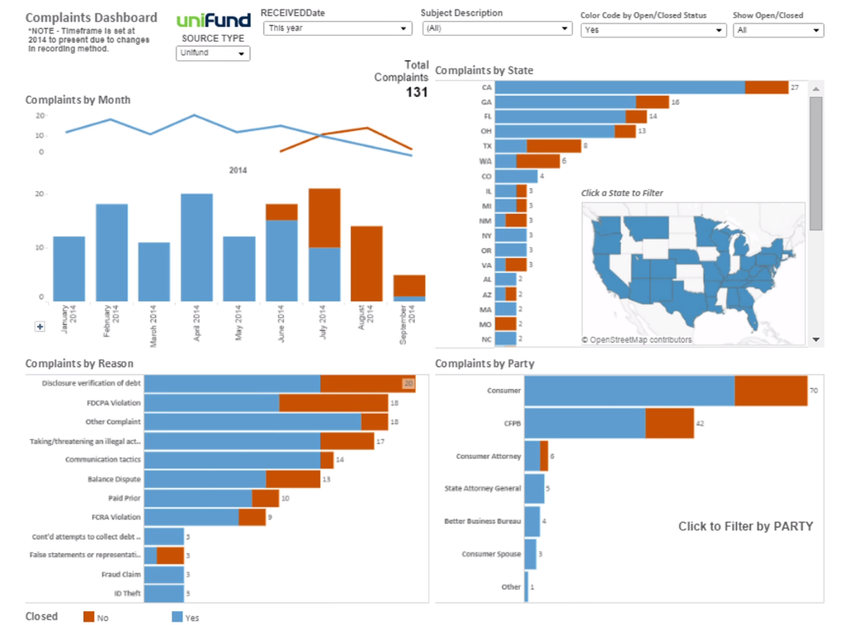

Let it Breath !!!

Slide 37
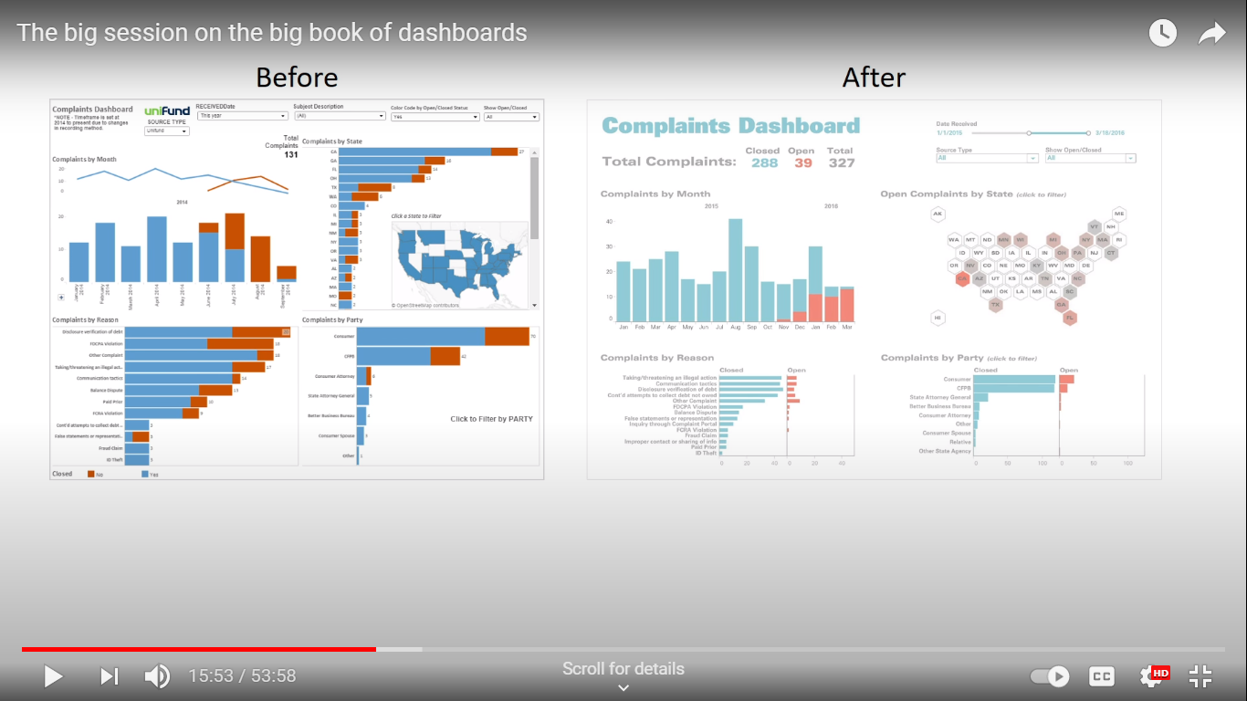

Slide 38
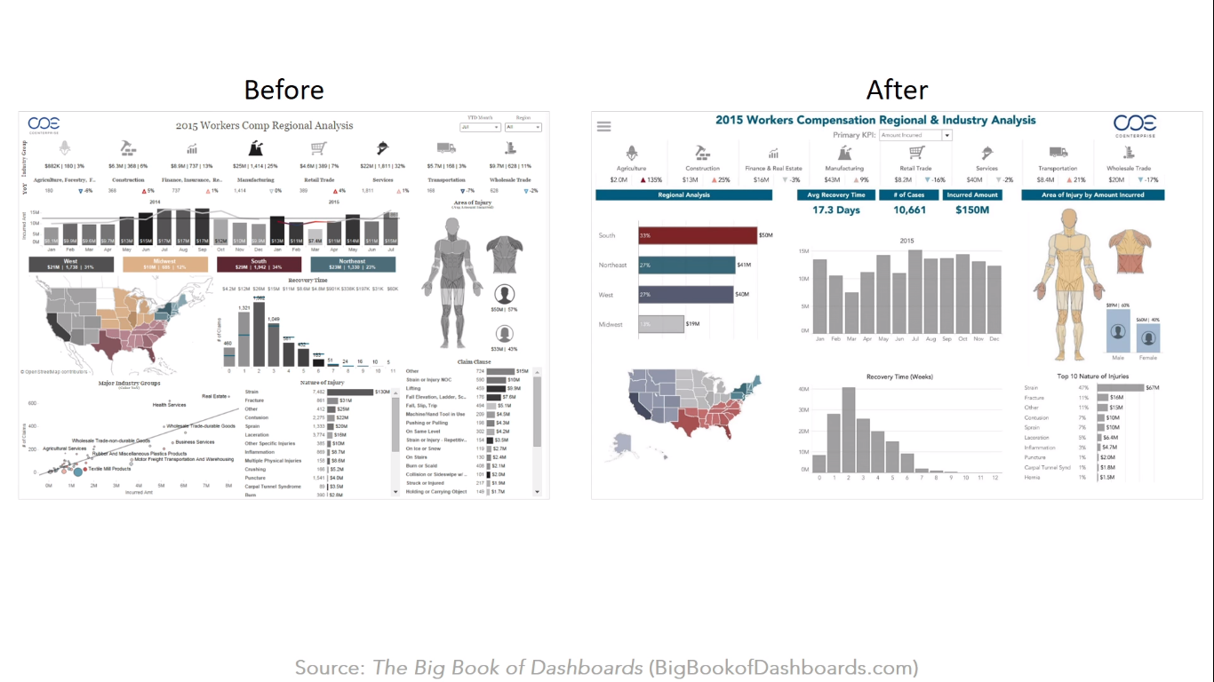

Slide 39
Does your dashboard pass the 5 second test?
Most important view is on top or top left
Legends are near their views
Avoid multiple color schemes
Uses 5 or fewer views (charts)
Provide interactivity
Titles
Axes& Units
Remove extra digits in numbers
Use familiar chart types.
Don’t make audience remember views.
Avoid large legends.
Use intuitive colors and shapes

Slide 40


Slide 41
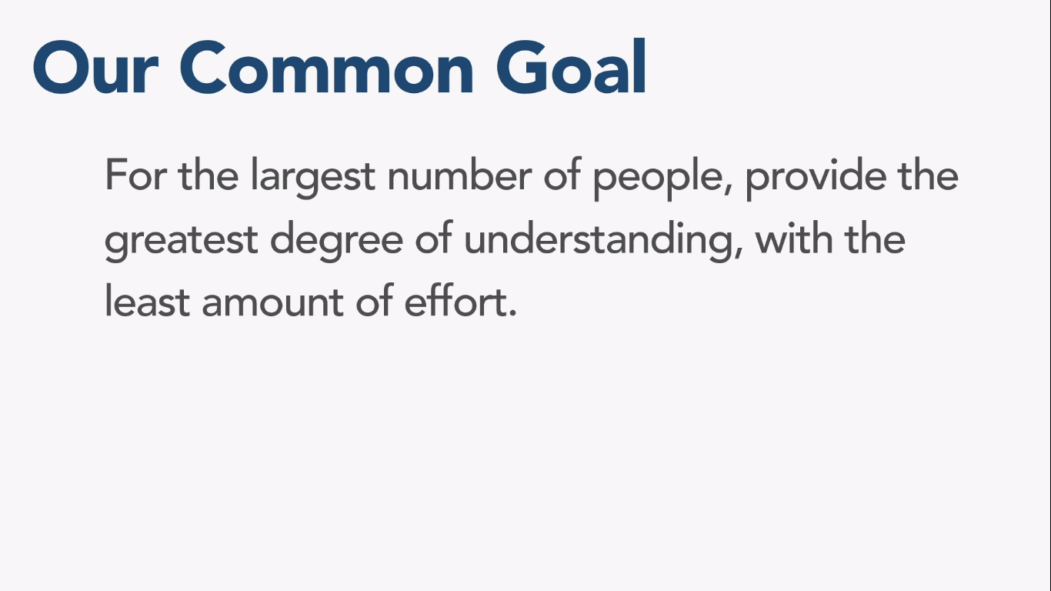

Slide 42
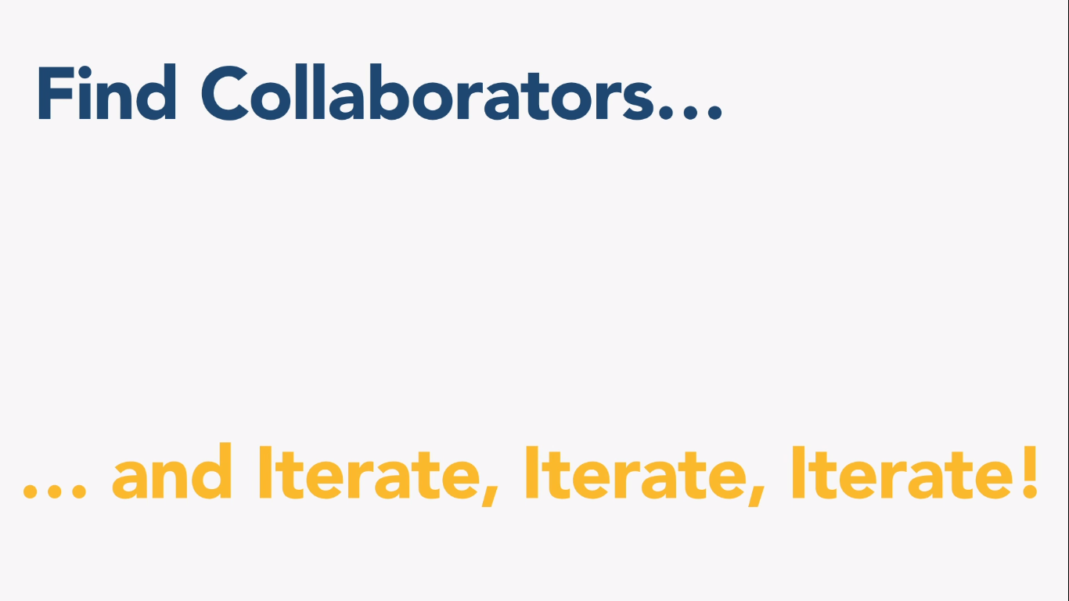

Slide 43
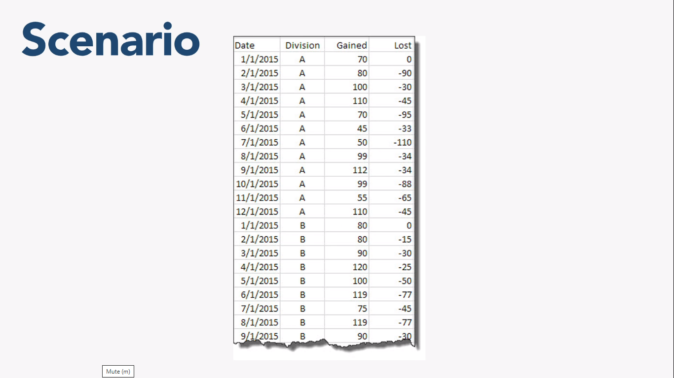

Slide 44
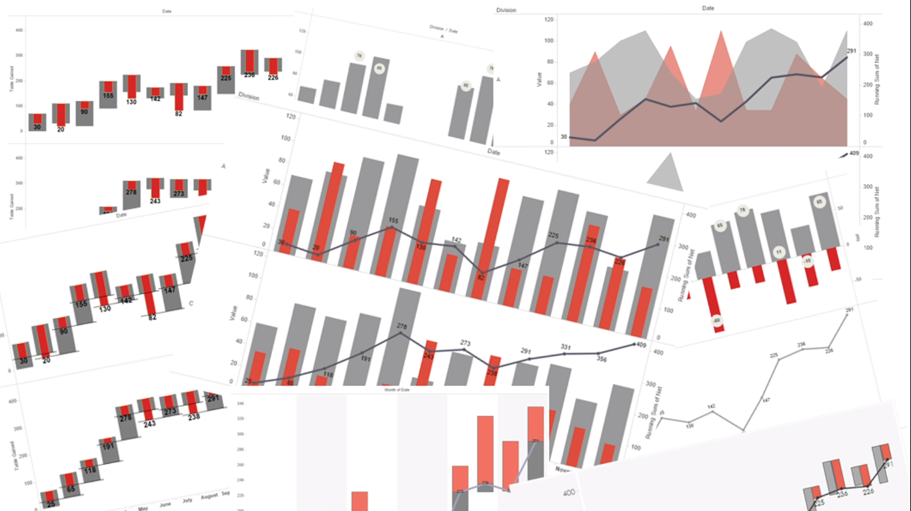
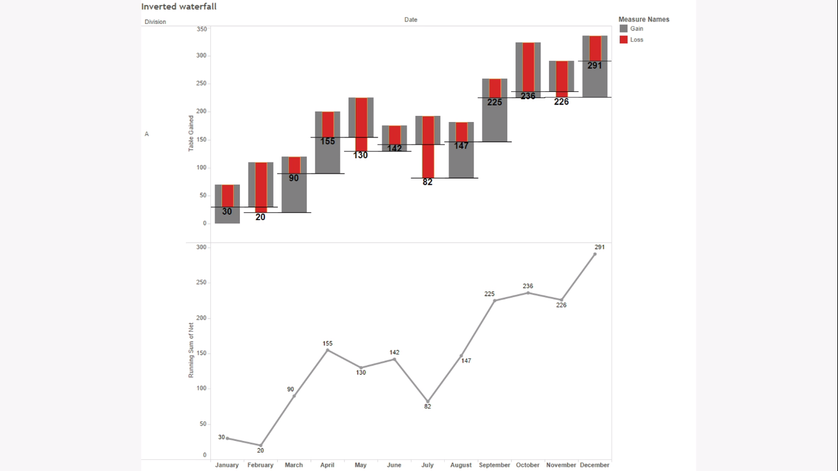

Slide 45
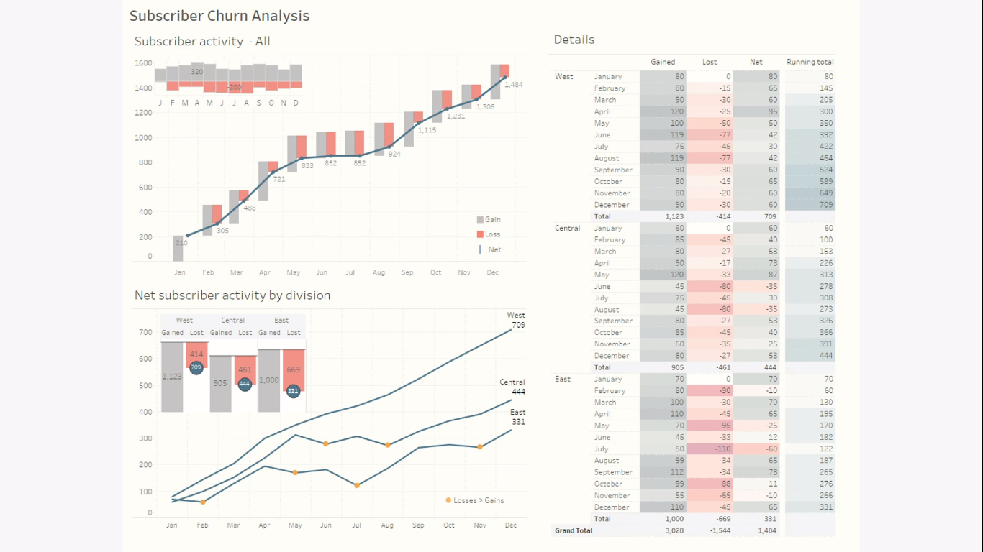

Slide 46
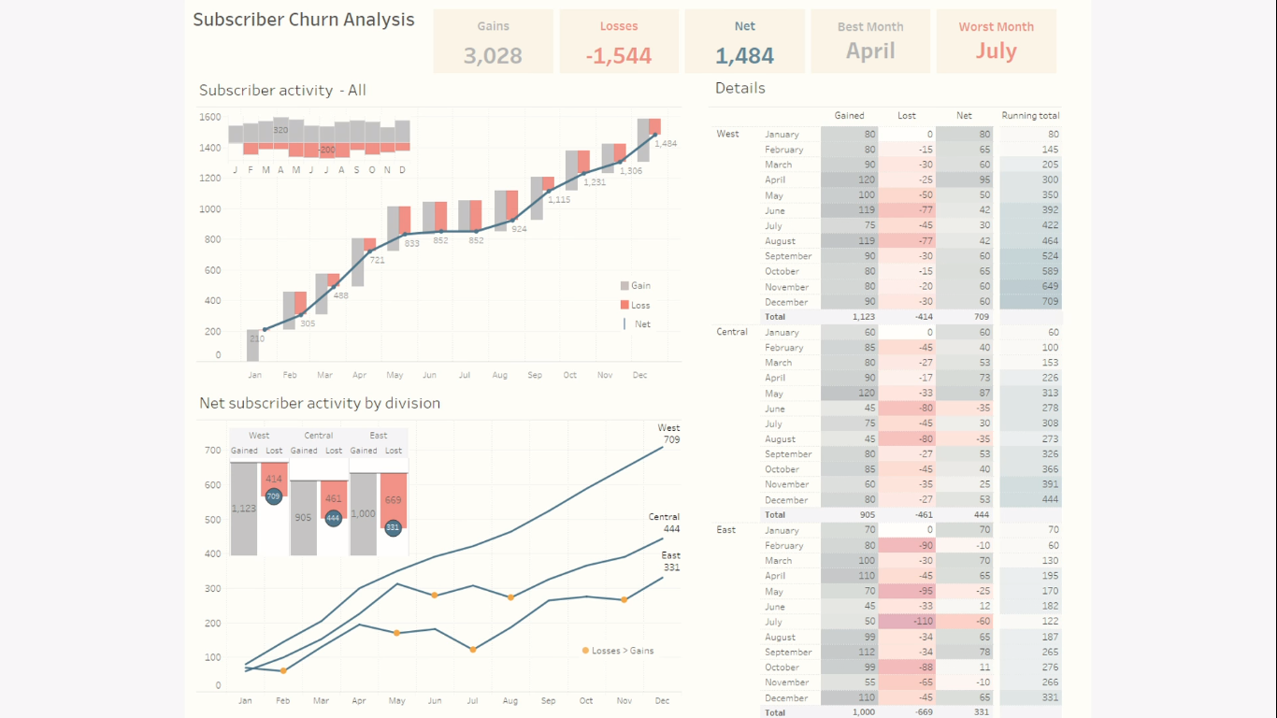

Slide 47
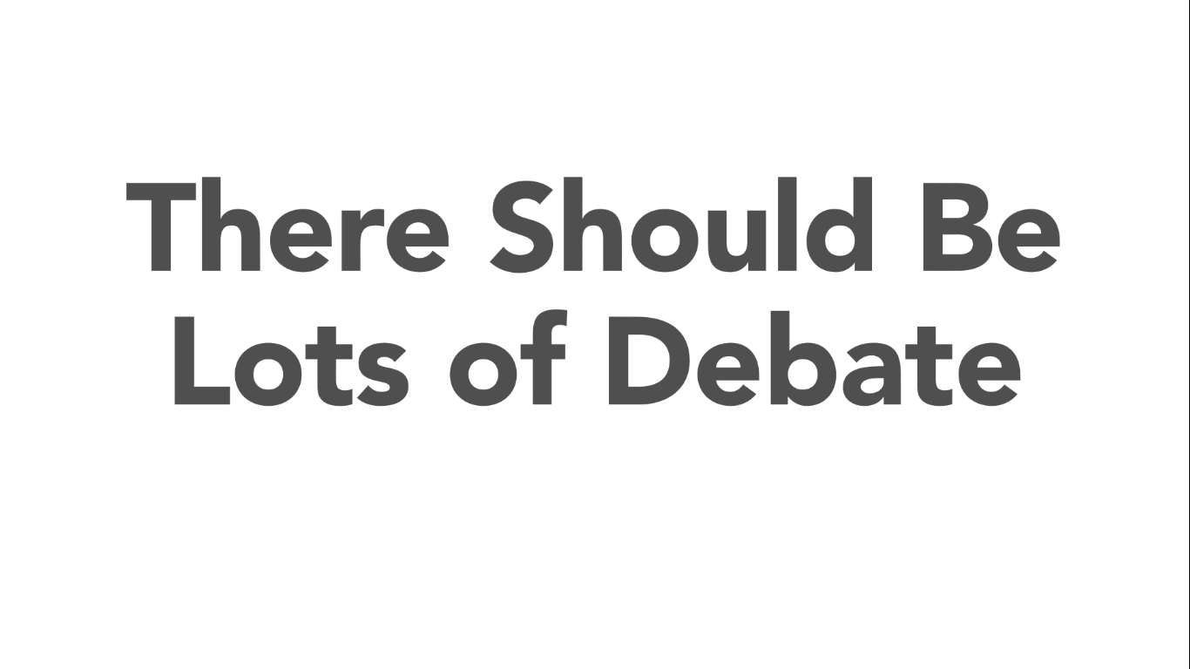

Slide 48
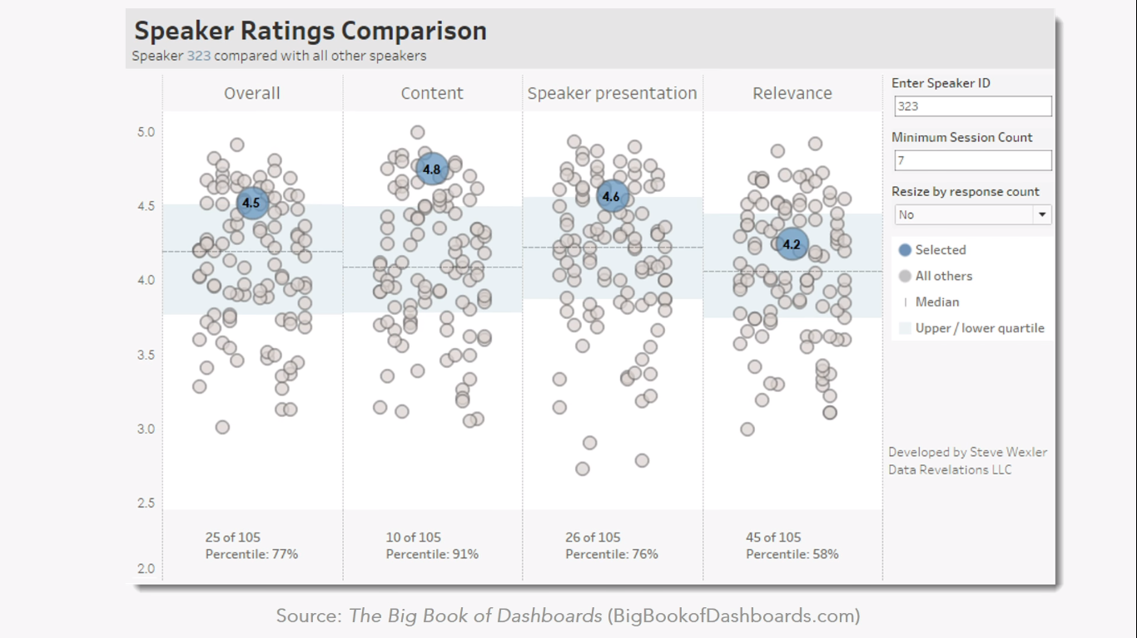

Slide 49
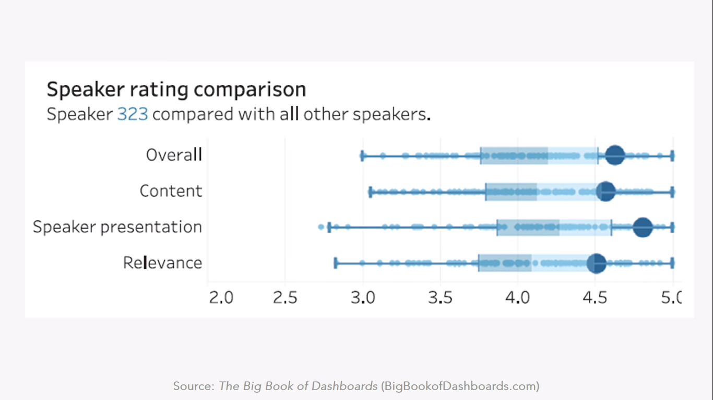

Slide 50
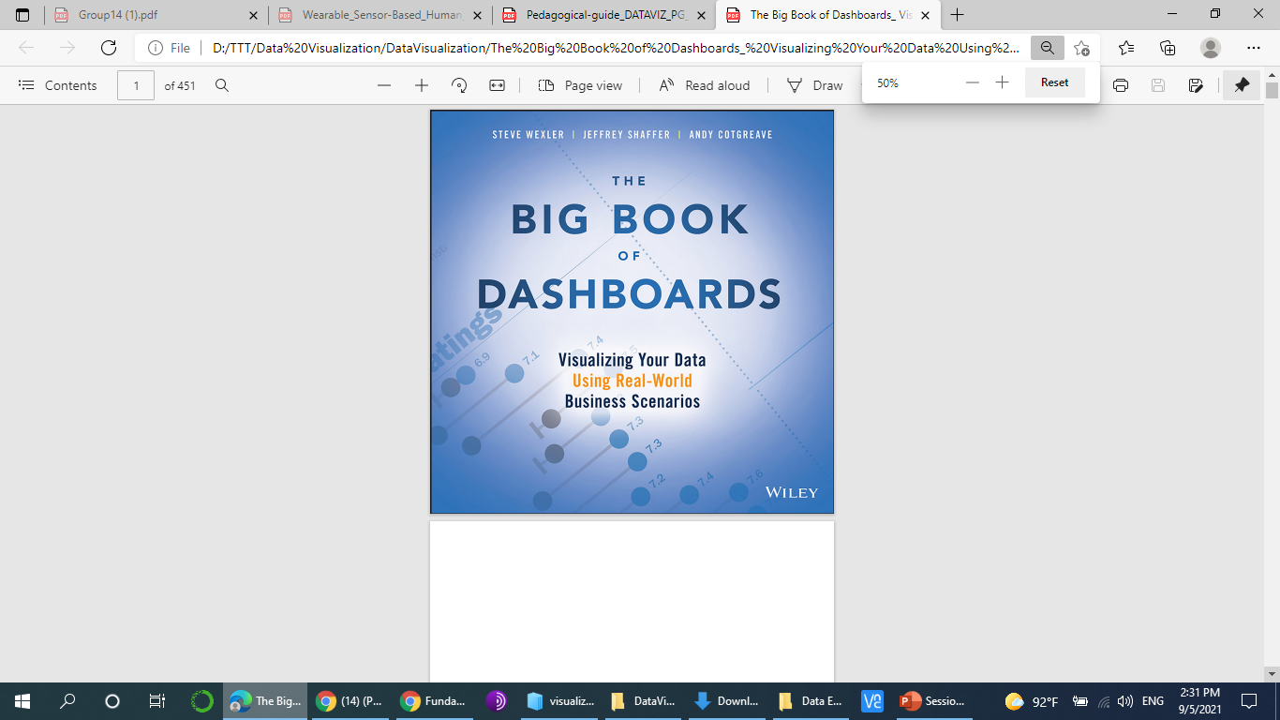




Want to read more about Visualization?
The Big Book of Dashboards
Fundamentals of Data Visualization – Claus O. Wilke
Visual Reporting and Analysis: Seeing is Knowing Whitepaper
Visual Analysis Best Practices: A Guidebook Whitepaper
Data Storytelling: Using visualization to share the human impact of numbers Whitepaper
Beautiful Evidence – Edward Tufte
Information Dashboard Design – Stephen Few
Information Visualization – Colin Ware
Data Visualization: A Handbook for Data Driven Design

Slide 51
Homework
The Groups (only 2 for each group)
The Scenarios
What is a story?
Expected layout
Make a figure for the generals
Build up towards complex figures
Make your figures memorable
Be consistent but don’t be repetitive
Example:
Monitor, report, and predict Egyptian airline performance.
Specifics:
Top 10 airline carrier in year 2019 in terms of number of flights.
Number of flights in 2019 split by month.
Number of travelers from Cairo to other cities.
………
Notes:
A couple of years ago, I (Andy) purchased a Fitbit. The wearable device tracks your daily activity, focusing on how many steps you walk each day, with a default 10,000-step target. For the first few months, this device and its online dashboard were hugely motivating. (See Figure 32.1.) Fitbit took something that was difficult to record, step count, and made it easy to track. The dashboard didn’t just reveal my daily walking patterns; it motivated me to change my behavior and walk more. The dashboard showed me which days I was failing (mostly on workdays) and allowed me to make strategies to After a while, I came to know everything the dashboard was going to tell me. I no longer needed to look at the dashboard to know how many steps I’d taken. The dashboard had educated me to make a good estimate without needing to look at it. Step count had, in other words, become a commodity fact. I’d changed my lifestyle, and the dashboard became redundant. Now my questions were changing: What were my best and worst days ever? How did my daily activity change according to weather, mood, work commitments, and so on? Fitbit’s dashboard didn’t answer those questions. It was telling the same story it had been telling on the first day I used it, instead of offering new insights. My goals and related questions were changing, but Fitbit’s dashboard didn’t.

Slide 52


Slide 53



Slide 54
Plotly and Dash
What libraries already exist to visualize data with python?
Matplotlib
“Grandfather” of them all.
Creates static image files.
Can create almost any plot type.

Slide 55
Plotly and Dash
What libraries already exist to visualize data with python?
Seaborn
Uses matplotlib on the background.
Designed to create nice looking statistical plots.(static plots)
Can only create statistical plots available in documentation.

Slide 56
Plotly and Dash
What libraries already exist to visualize data with python?
Pandas
Main purpose is data analysis
Uses matplotlib on the background through .plot().
Limited scope of plot types.
Can only create static plots.

Slide 57
Plotly and Dash
What is Plotly?
Plotly the open source library is a general data visualization library focused on interactive visualizations.
Plotly has libraries for JavaScript, React, R and Python.
The most popular version is the Python library.
Using the Plotly python library by itself creates interactive plot as .html files.
While users can still interact with theses plots (zoom in, select, hover over).

Slide 58
Plotly and Dash
What is Plotly?
Once the interactive Plotly plot is generated, the data the plot represents is “locked in” to the exported state of the plot.
You would need to re-run the .py script and re-generate the .html file to see any updates.

Slide 59
Plotly and Dash
What is Dash?
Often users want plots to be able to interact with each other, interact with components, or have plots update in real time.
To accomplish this level of tasks, we need a dashboard.

Slide 60
Plotly and Dash
What is Dash?
Dash is an open-source library from the Plotly company that allows you to create a full dashboard with multiple components, interactivity, and multiple plots.
Instead of creating an.html file, Dash will produce a dashboard web application at a local URL (127.0.0.1:8050).
You can the visit and interact with this dashboard in the web application.
Since Dash renders a full web app, you can then deploy your dashboards online.

Slide 61
Plotly and Dash
Conclusion
Python has many visualization libraries(static)
Plotly creates interactive images.
Dash creates dashboard web apps.
To fully understand Dash, we should first get comfortable with Plotly.

Slide 62
Data Visualization in Data Science
The First Mile …
… and the Last Mile.
Plotly Express
Dash
Making graphics in a single function call.
Quickly iterate through various visual forms
Easily tailor graphics for publication
Make web application that link graphics, controls & text
Control every aspect of styling and layout
Easily deploy anywhere Flask can run
Pip install plotly
Pip install dash
Pip install jupyter_dash
Notes:
Dash is an open-source framework for building analytical applications, with no Javascript required, and it is tightly integrated with the Plotly graphing library.

Slide 63
Plotly – An Overview
Interactive, open-source plotting library.
Support over 40 unique chart types.
Include chart types like statistical, maps, scientific, and 3-D.
Visualization can be displayed in Jupyter notebook, saved to Html files, or can be used in developing python- built web applications.
Plotly Notebook
Notes:
Have 2 sub modules

Slide 64



Plotly Sub-modules

Slide 65


Notes:
Full Page Image w Color Bar

Slide 66
THANK YOU!
Notes:
Full Page Image w Color Bar

